Slide 1
SD Progress Report July 31, 2013
Brian Thibodeau

Slide 2
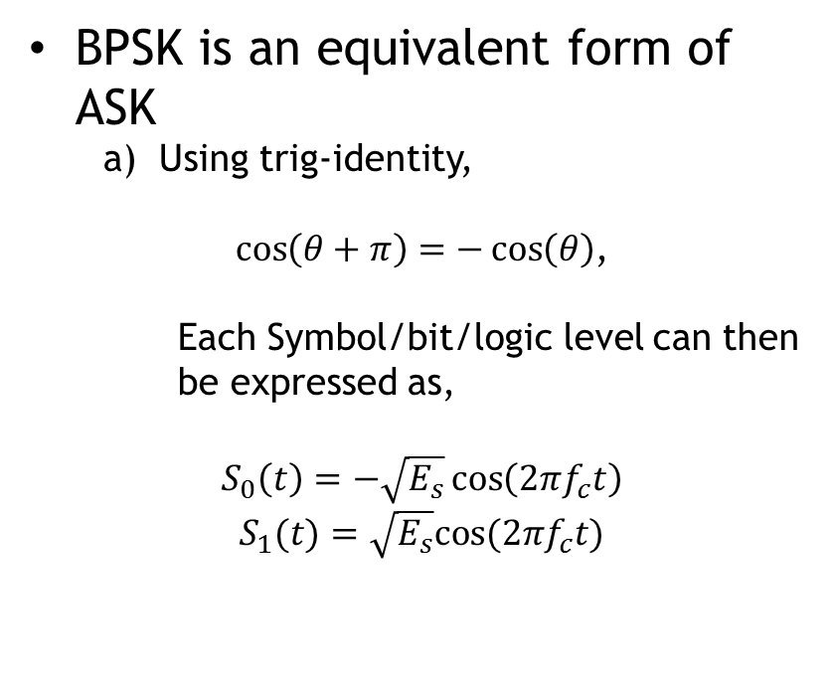
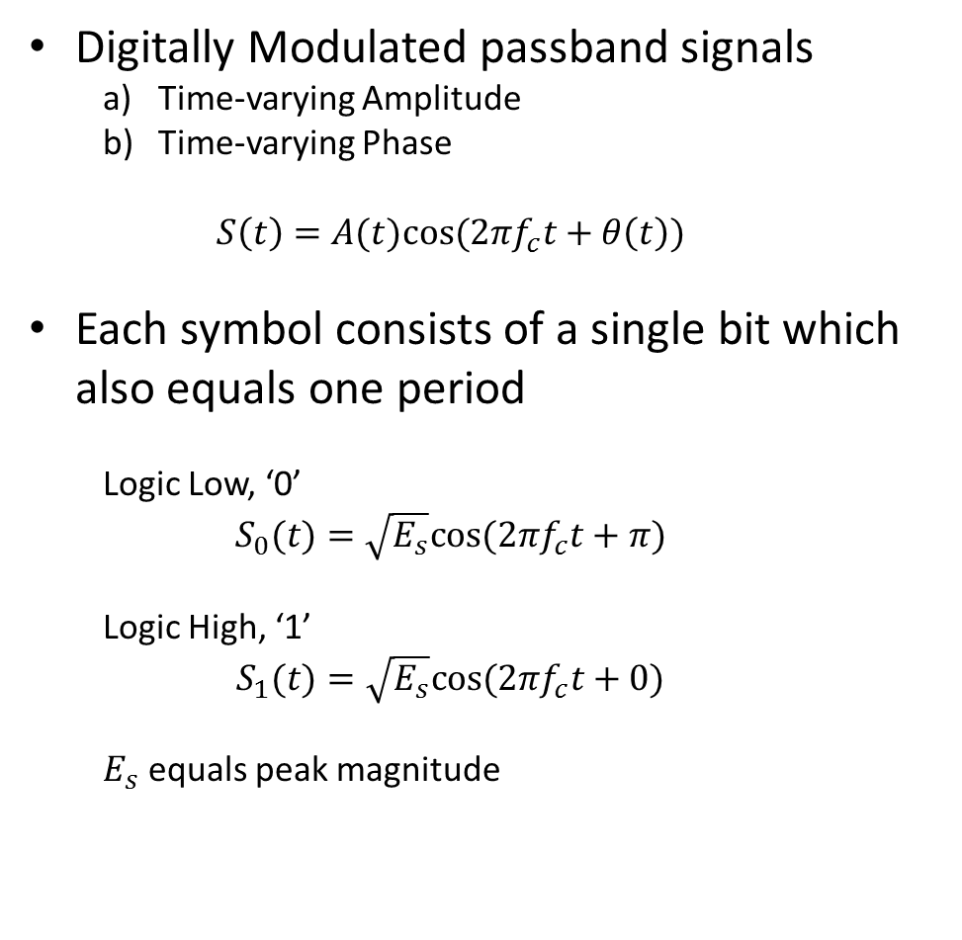
Properties of BPSK Modulation
Digitally Modulated passband signals
Time-varying Amplitude
Time-varying Phase
$$S\left(t\right)=A(t)cos⁡(2πf_{c}t+θ\left(t\right))$$
Each symbol consists of a single bit which also equals one period
Logic Low, ‘0’
$$S_{0}(t)=\sqrt{E_{s}}cos⁡(2πf_{c}t+π)$$
Logic High, ‘1’
$$S_{1}(t)=\sqrt{E_{s}}cos⁡(2πf_{c}t+0)$$
$E_{s}$ equals peak magnitude
BPSK is an equivalent form of ASK
Using trig-identity,
$\cos\left(θ+π\right)=−\cos\left(θ\right)$,
Each Symbol/bit/logic level can then be expressed as,
$$S_{0}\left(t\right)=−\sqrt{E_{s}}\cos\left(2πf_{c}t\right)$$
$$S_{1}(t)=\sqrt{E_{s}}cos⁡(2πf_{c}t)$$

Slide 3
NRZI and Manchester Encoding
NRZI
Transitions occur on posedge of clock
Manchester Encoding
Special case of BPSK
clk
data
1
1
1
0
1
1
1
1
0
1
1
1
1
0
1

Slide 4
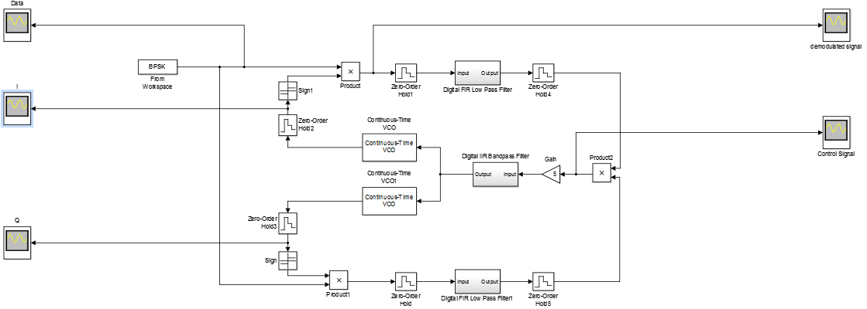


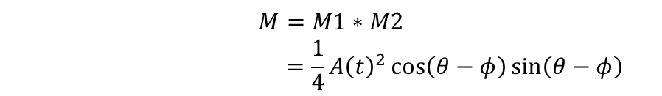



Costas Loop
$$M1=S\left(t\right)I\left(t\right)$$
$=\frac{1}{2}A\left(t\right)\cos\left(θ−φ\right)$
$+\frac{1}{2}cos⁡(4πf_{c}t+θ+ϕ)$
Filtered out by FIR Low Pass Filter
S(t)=$A(t)cos⁡(2πf_{c}t+θ)$
$$I\left(t\right)=cos⁡(2πf_{c}t+φ)$$
$$M=M1∗M2$$
$$=\frac{1}{4}{A\left(t\right)}^{2}\cos\left(θ−φ\right)\sin\left(θ−φ\right)$$
Q$\left(t\right)=sin⁡(2πf_{c}t+φ)$
$$M2=S\left(t\right)Q\left(t\right)$$
$=\frac{1}{2}A\left(t\right)\sin\left(θ−φ\right)$

Slide 5
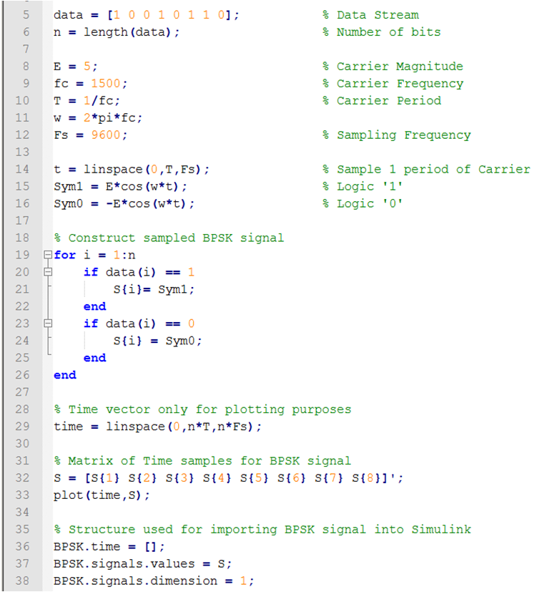
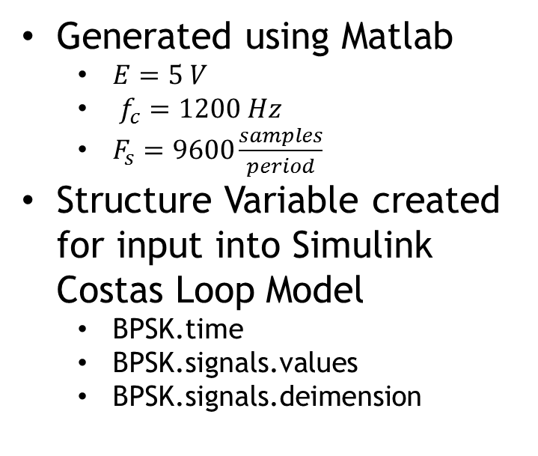
BPSK Test Signal
Generated using Matlab
$E=5 V$
$f_{c}=1200 Hz$
$F_{s}=9600\frac{samples}{period}$
Structure Variable created for input into Simulink Costas Loop Model
BPSK.time
BPSK.signals.values
BPSK.signals.deimension

Slide 6
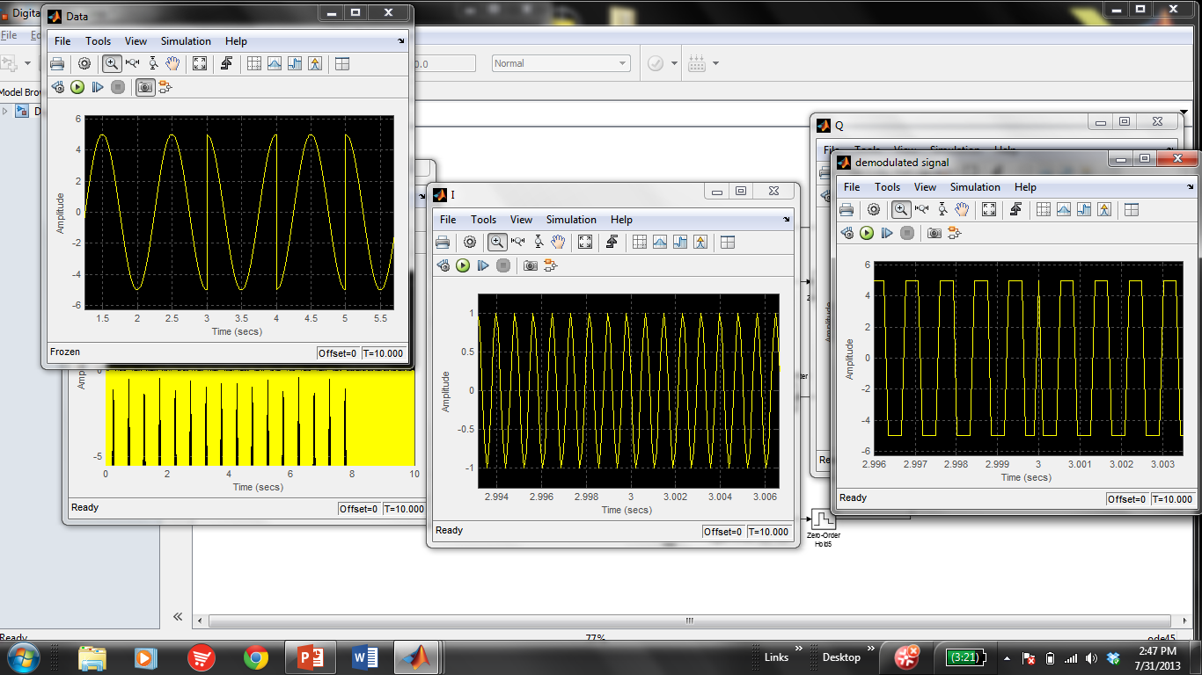
Initial Results of Costas Loop Simulation
BPSK Input Signal
Carrier From VCO
Demodulated Signal

Slide 7
References
[1] H. Yuan, X. Hu, and J. Huang, “Design and Implementation of Costas Loop Based on FPGA,” IEEE Trans. DOI: 978-1-4244-1718, 2008
[2] Z. Yang, Y. Bai, and Z. Zhao, “Design and Implementation of the Digital Costas Loop Based on Software Defined Radio,” IEEE Trans. DOI: 978-0-7695-4519-6, 2011

